Slide 1
Real-Time Resiliency Monitoring and Decision Support (RT-RMOD)
Anurag K. Srivastava, Sanjeev Pannala and Subir Majumder
West Virginia University
Email: anurag.srivastava@mail.wvu.edu
Panel Session presentations for the 2022 IEEE Power & Energy Society General Meeting
Thursday, July 21, 2022

Slide 2
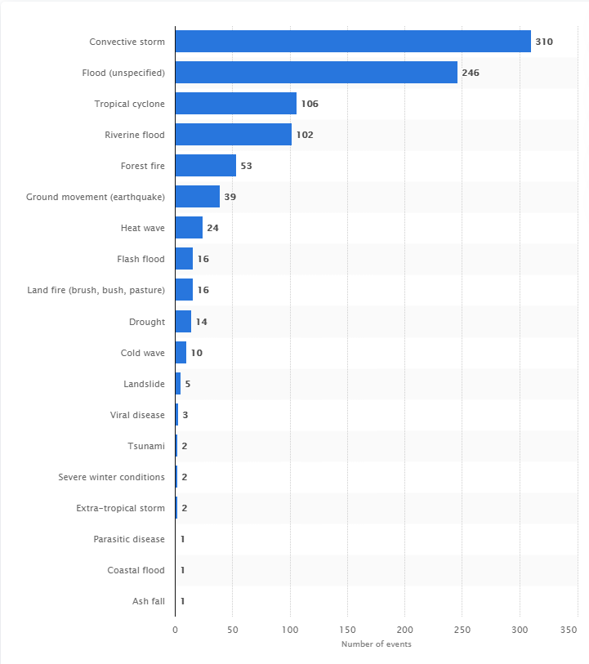
Adverse Weather Events and Grid Resiliency
Number of natural disasters in the United States from 1900 to 2016
Motivation
Number of increasing weather and cyber events
Challenges
Data need and integration with existing legacy tool
Develop tool for resiliency monitoring and control
Ability to estimate impact of weather events
Deployment challenges
Proper assessment of system condition

Slide 3
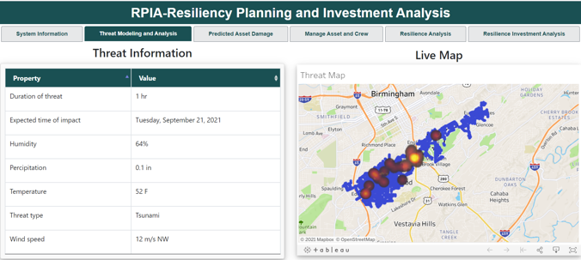
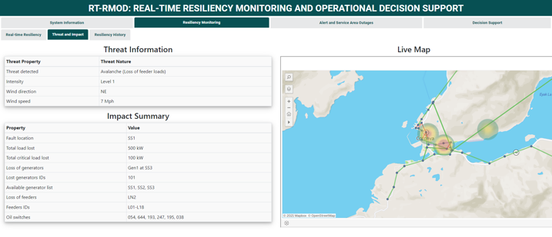
RPIA: Resiliency Planning and Investment Analysis
Tools for Situational Awareness and Decision Support for Power grid Resiliency
RT-RMOD: Real-Time Resiliency Monitoring and Operational Decision

Slide 4
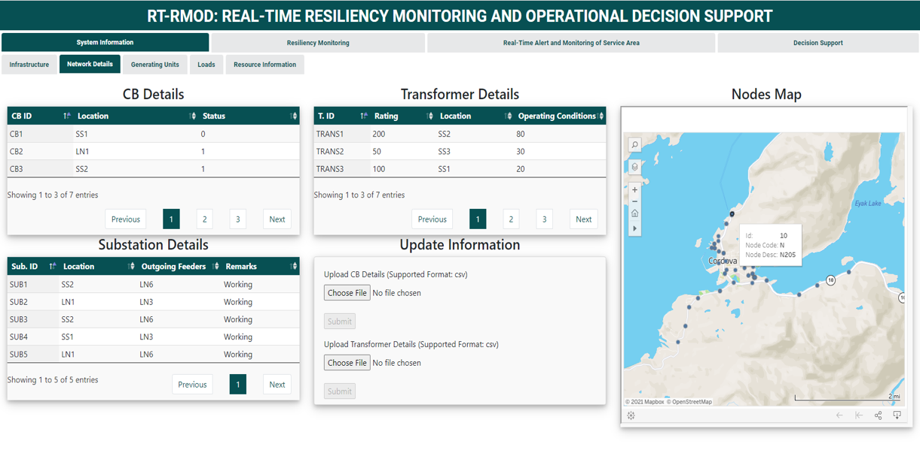
RT-RMOD
https://resilientpowergrid.ai/rt-rmod/index.htm.

Slide 5
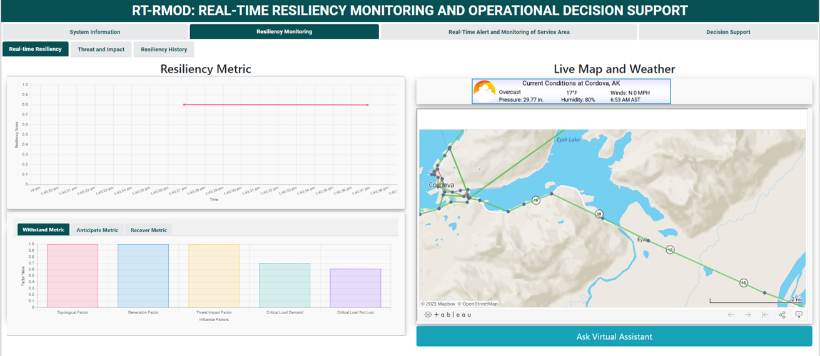
RT-RMOD
https://resilientpowergrid.ai/rt-rmod/index.htm.

Slide 6
Defining Resilience
Multiple definitions exist.
Focus on critical loads for distribution grids.
"Resilience – Ability of the system to supply its critical loads, even in the presence of multiple contingencies".
FERC: The ability to withstand and reduce the magnitude and/or duration of disruptive events, which include the capacity to anticipate, absorb/withstand, adapt to, and/or rapidly recover from such an event.
IEEE PES PSDP definition and metric for resilience WG, PES T&D Distribution System Resiliency, PSOPE tools for resilience, AMPS Resilience Metrics and Evaluation Methods and CIGRE WG 4.47 and 2.25
G. Kandaperumal, A.K. Srivastava, “Resilience of the Electric Distribution Systems: Concepts, Classification, Assessment, Challenges, and Research Needs”, IET Cyber-Physical Systems:
Theory & Applications, 2019

Slide 7
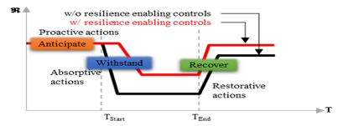
Anticipate
How well is the system prepared for the predicted impact of an incoming event?
Before Event
Withstand
A.W.R.
How well can system continue to supply critical loads during event?
Inspired by CDC Public Health Emergency Preparedness and Response and Weighted Sum Model (WSM).
Recover
How quickly can system recover from event and continue supply to critical loads? And at what cost?
Measuring Resilience

Slide 8
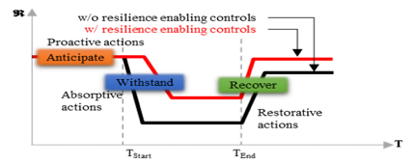
Anticipate
How well is the system prepared for the predicted impact of an incoming event?
During Event
Withstand
A.W.R.
How well can system continue to supply critical loads during event?
Using system characteristics-based factors, graph theory, and Multi-Criteria Decision Making (MCDM): Analytical Hierarchal Process (AHP).
Recover
How quickly can system recover from event and continue supply to critical loads? And at what cost?
Measuring Resilience

Slide 9
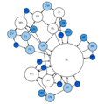
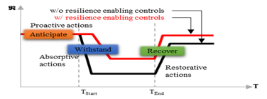
Anticipate
How well is the system prepared for the predicted impact of an incoming event?
After Event
Withstand
A.W.R.
How well can system continue to supply critical loads during event?
Using system characteristics-based factors, graph theory, and Multi-Criteria Decision Making (MCDM): Analytical Hierarchal Process (AHP).
Recover
How quickly can system recover from event and continue supply to critical loads? And at what cost?
Measuring Resilience

Slide 10
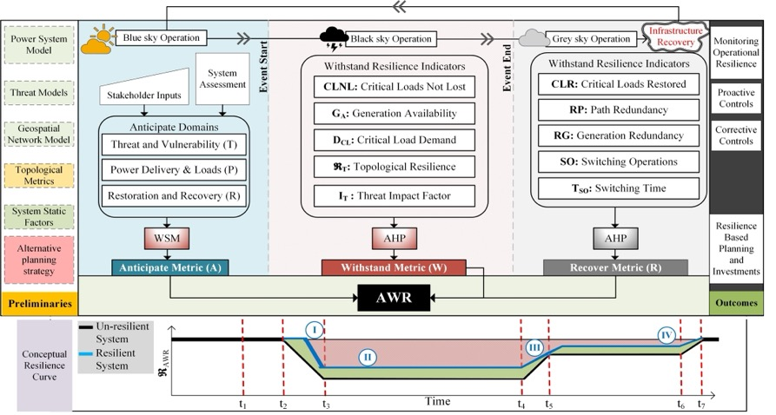
Multi-temporal Multidimensional Resilience Measure

Slide 11
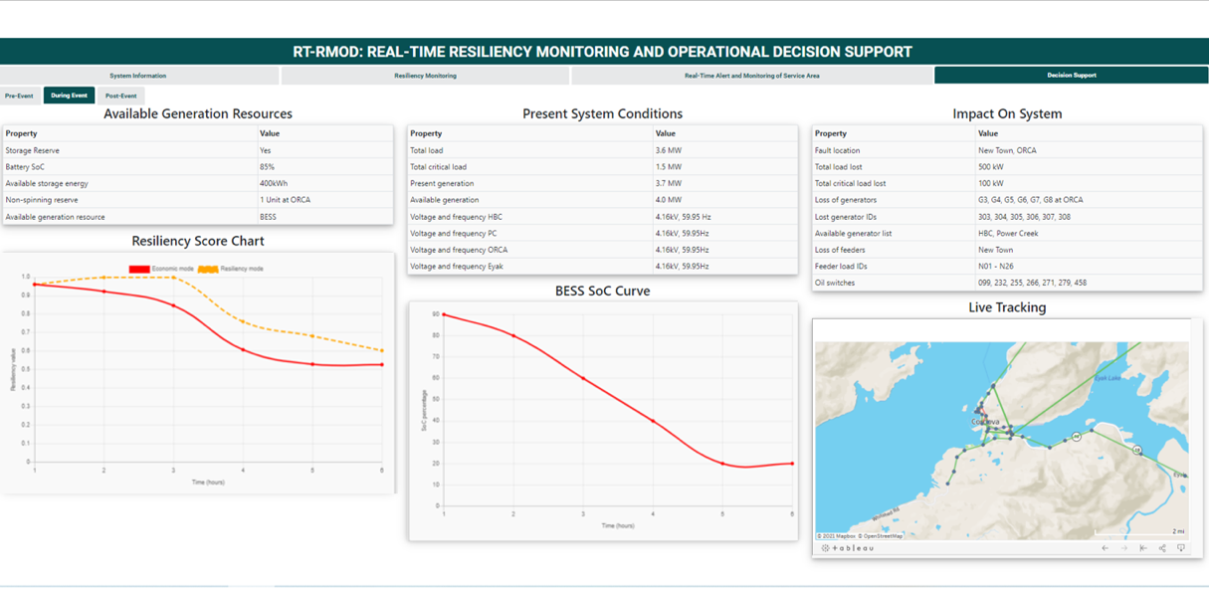
RT-RMOD

Slide 12
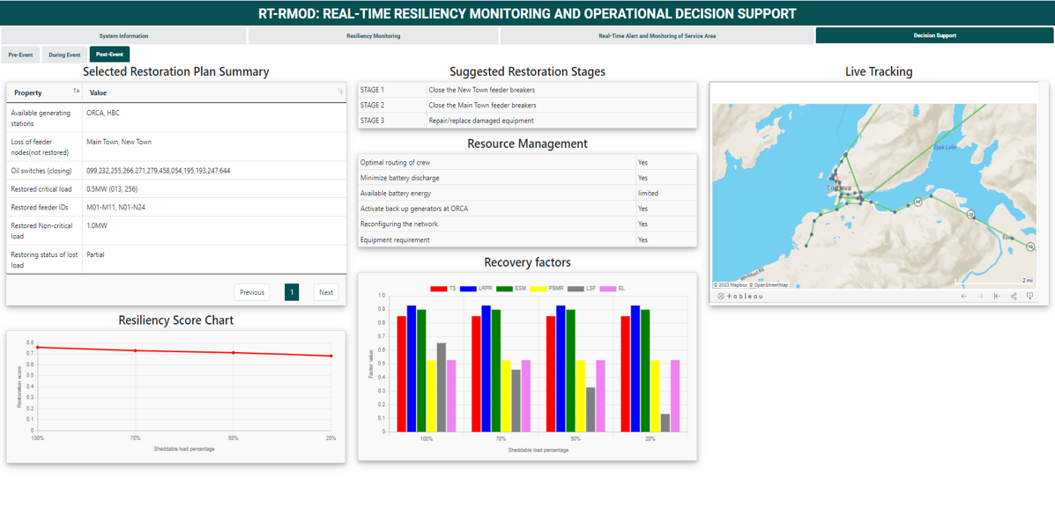
RT-RMOD

Slide 13
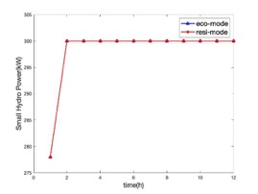
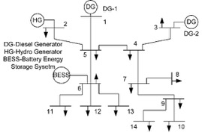
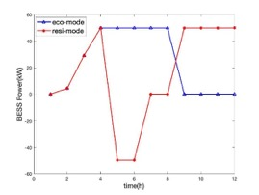
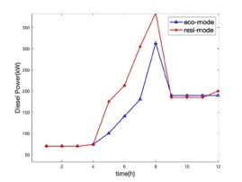
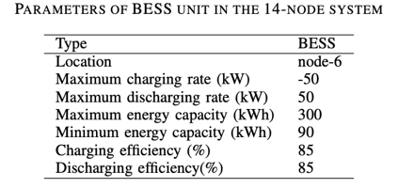
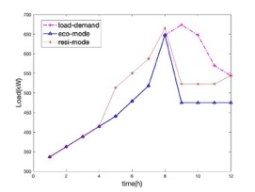
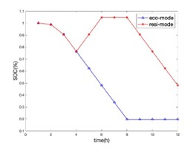
Test case-1
Revised 14-nodes test case
Assume DG-2 outage at hour-9 because of an event-strike, and event alert is received at hour-4.
In eco-mode, BESS has reached the minimum SOC limit when event-strike happened.

Slide 14
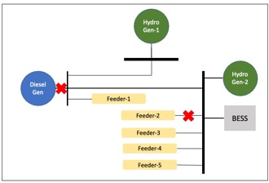
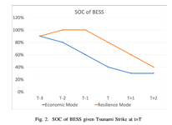
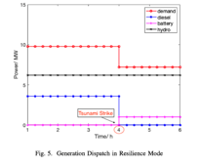
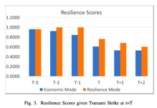
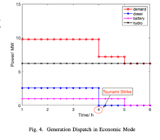
Test case-2
55-node islanded microgrid
Resilience-mode guarantee better resilience than economic-mode

Slide 15
RT-RMOD Case Scenario: Two Stage Proactive Control
Outage of energized lines and energized generators due to expected events will cause more impact compared to unenergized lines and generators
Not all available switches available at the disposal of the operator are remotely operable
When the forecast is certain, and disaster cannot be avoided, switching operations are important for resiliency improvement
Two stage includes manually operated switch followed by automatic switches

Slide 16
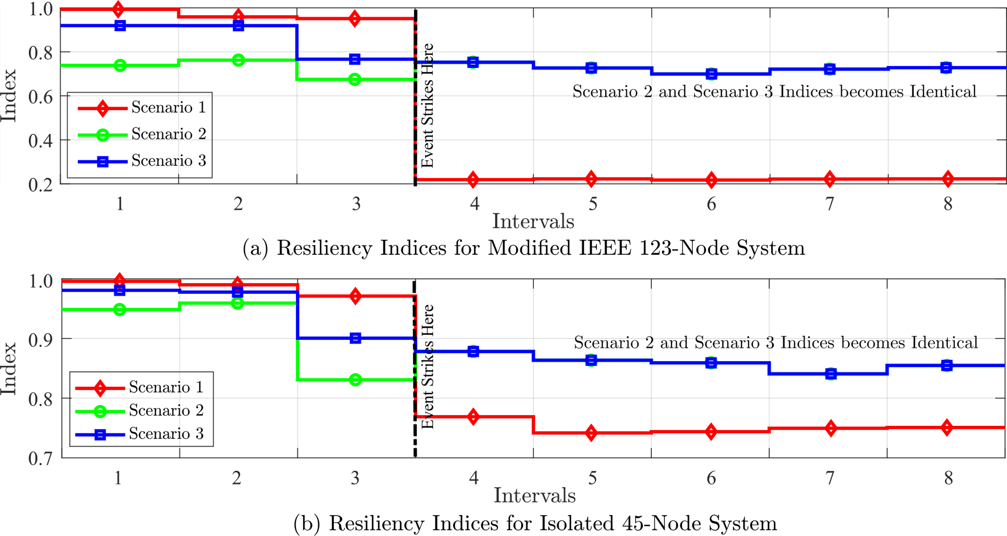
Two-Stage Proactive Control: Results
Scenario 1: Disaster strikes upon the network without prior preparation
Scenario 2: Network is proactively reconfigured, but, to be outaged part removed apriori
Scenario 3: Outaged part is operated through remote switches, only minutes before

Slide 17
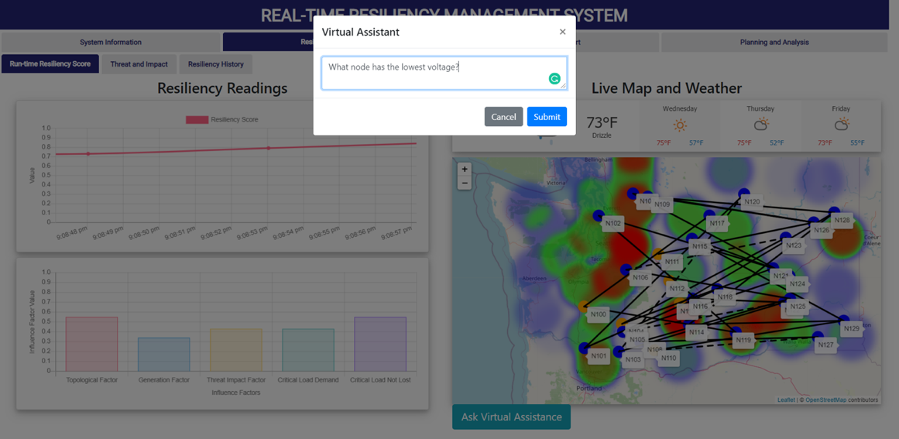
DINGO: Digital assIstaNt for Grid Operators (NLP based)
17

Slide 18
Summary
During extreme weather events, situational awareness and decision support is important for grid operator and tools is required
Resiliency Metric is needed for comparing alternative control actions
Proactive control and corrective control are needed for operators or as autonomous control
RT-RMOD provides resiliency monitoring and decision support

Slide 19
Thanks to the DOE RADIANCE, DOE UI-ASSIST and NSF FW-HTF projects for supporting this work

