Slide 1
PEDES – 2022
2022 IEEE 10th Power Electronics, Drives and Energy Systems
Dec 14th - 17th , 2022
Impact Analysis of Cyber-Events on Distributed Voltage Control with Active Power Curtailment
Paper– ID: 460
Partha S. Sarker, Subir Majumder, Md Fazley Rafy and Anurag K. Srivastava
West Virginia University, WV, USA

Slide 2
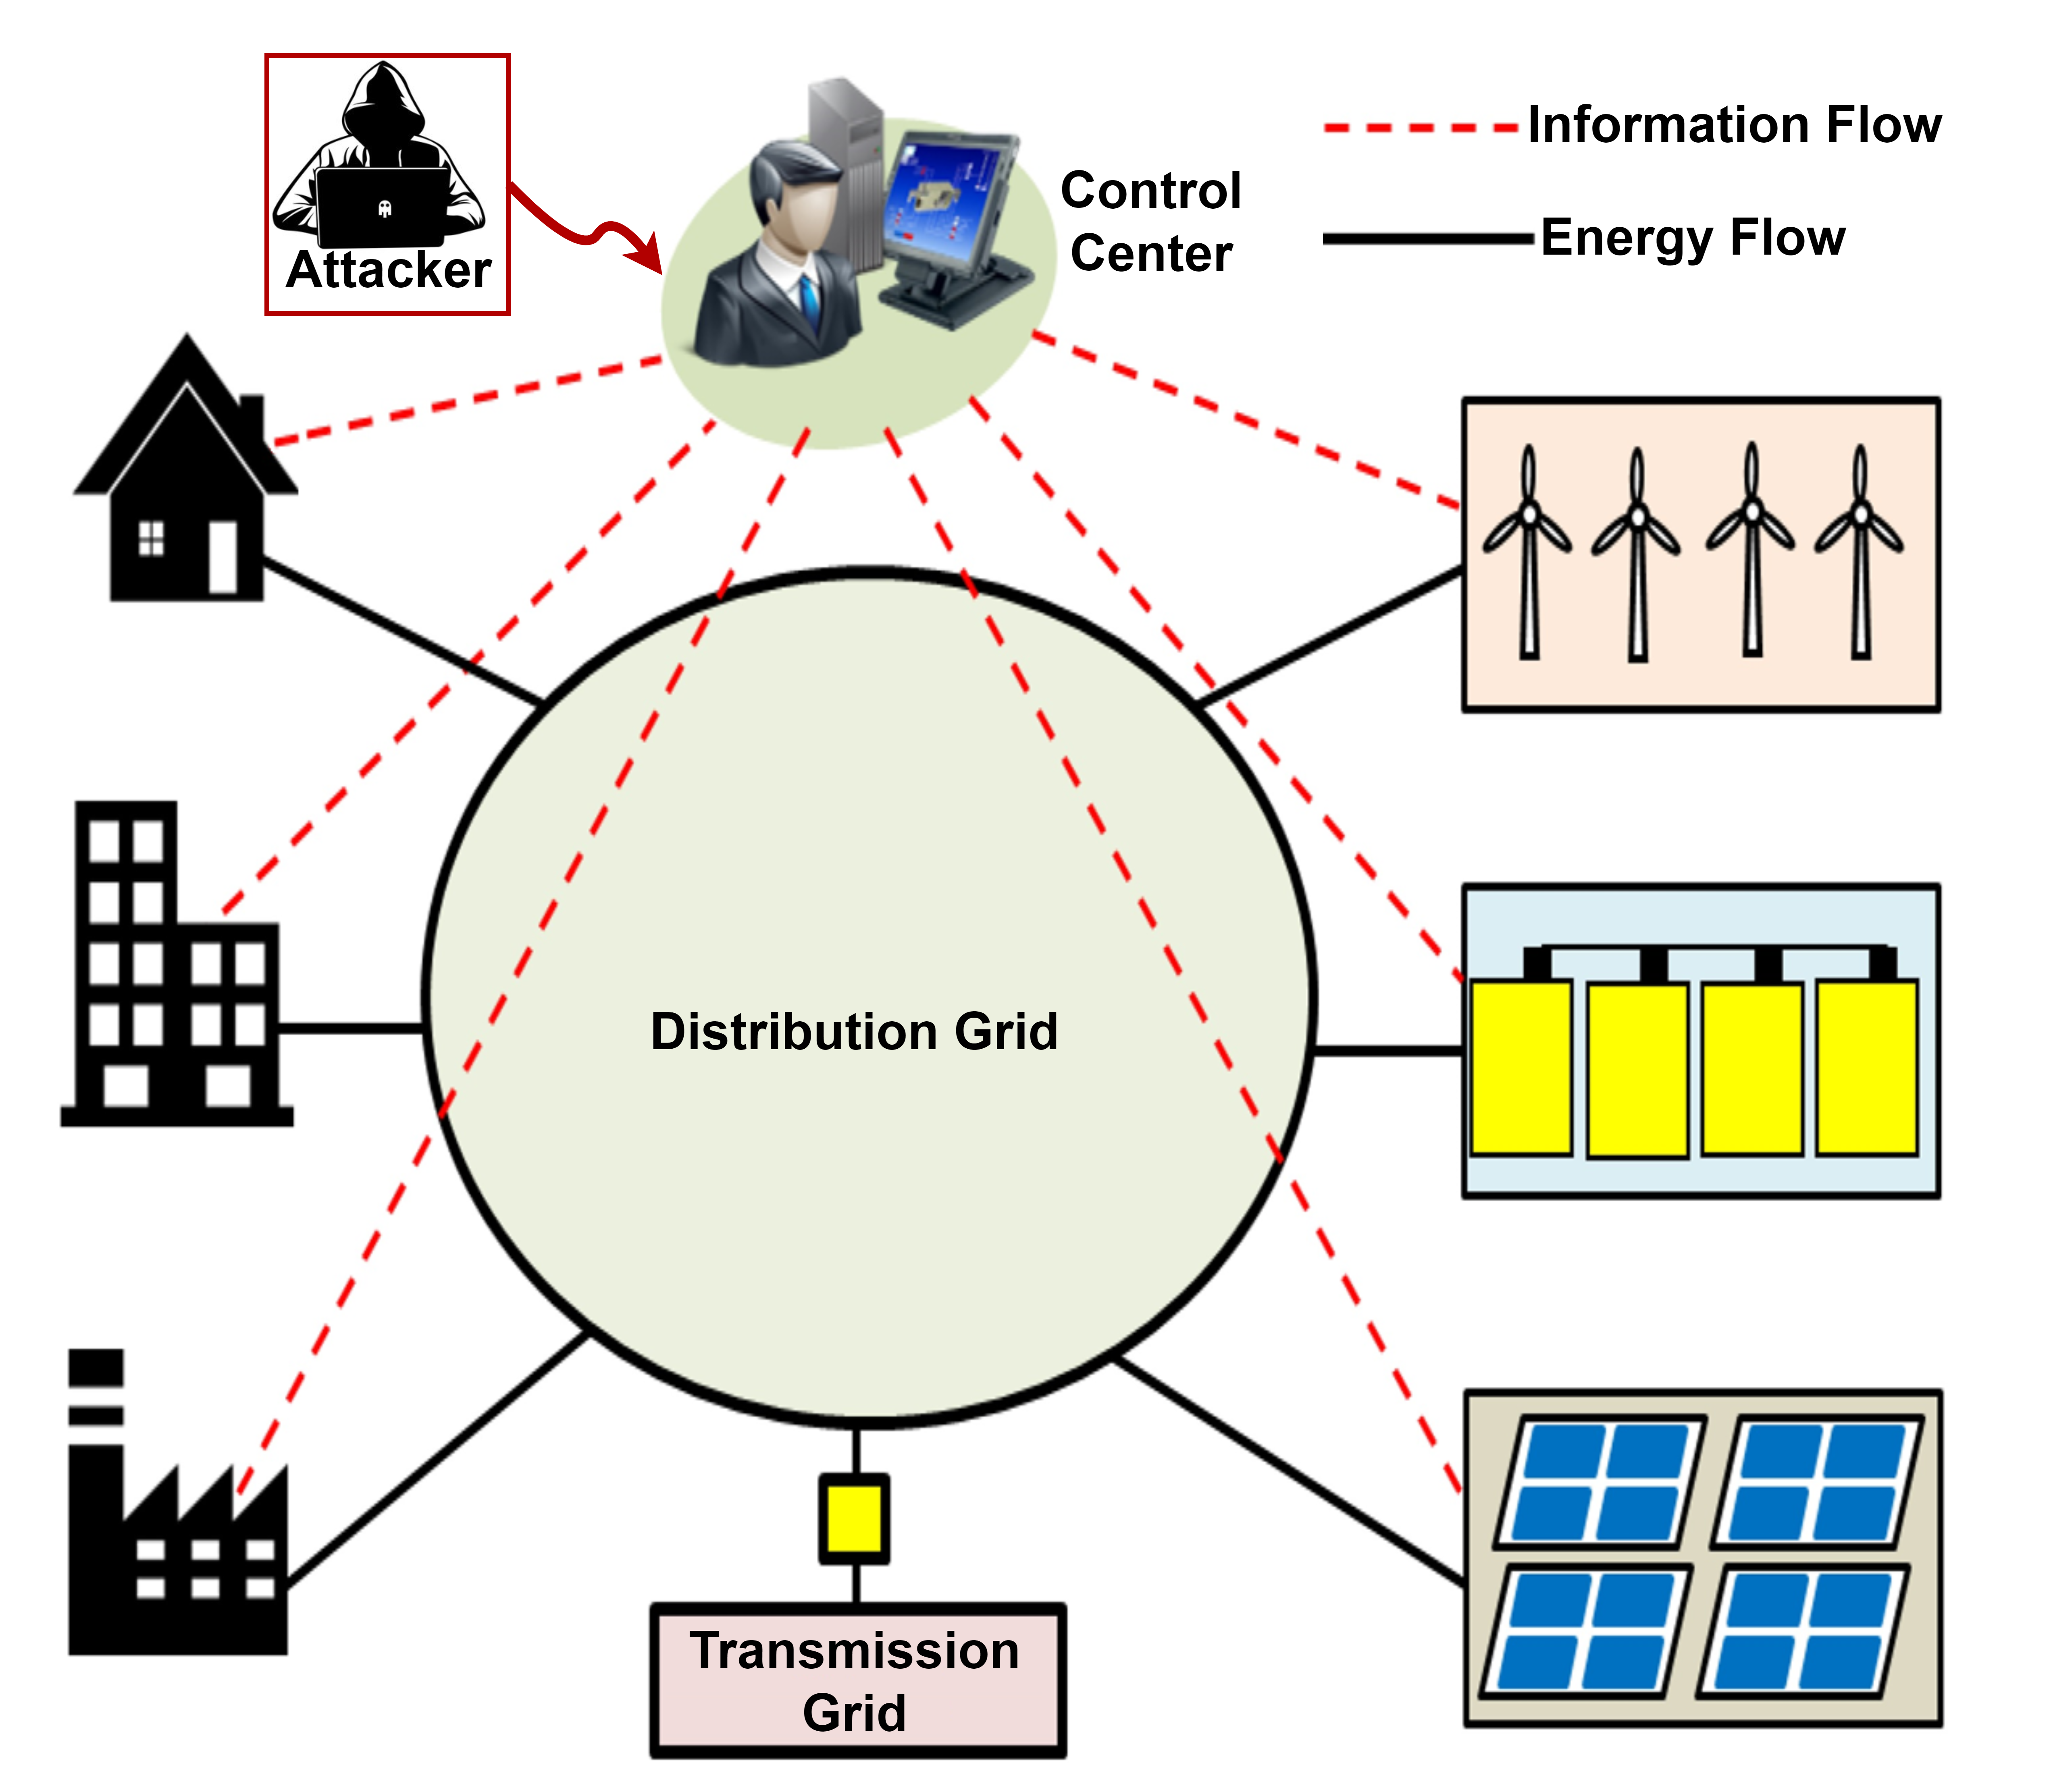
Motivations
Coordination and scalability challenges with typical control center-based approaches?
Centralized control center-based architecture with single-point of failure (with backup) → Vulnerable information and communication technologies (ICTs)
Distributed controls → Data need not be aggregated at centralized location → How to communicate?
Need to be evaluated with actual ICTs based network under realistic cyber-attacks?

Slide 3
Contributions
Distributed feedback-based volt-watt controller that guarantees asymptotic convergence of voltage-related constraints
Implemented realistic cyber-attacks (specifically, Man in the Middle, Denial-of-Service, Replay attacks) within Mininet network emulator with the capability of attacking multiple hosts in the communication layer
Performance evaluation of the proposed distributed Volt-Watt algorithm during different cyber-attacks

Slide 4
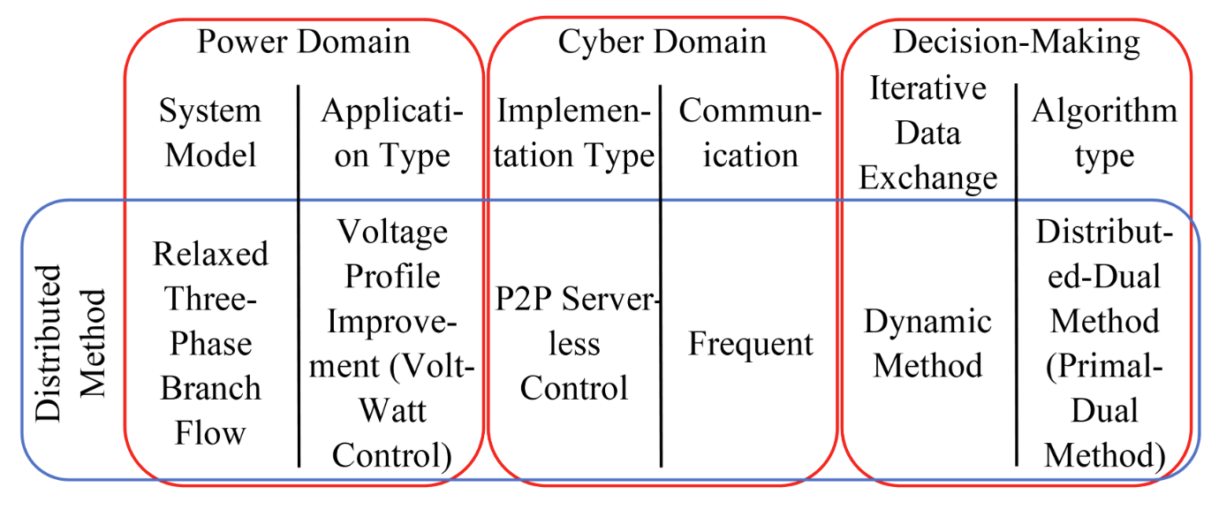
Distributed Volt-Watt Optimization
Varying performance with distributed approaches
How to compare the performance of a given distributed algorithm compared to other algorithms?

Slide 5
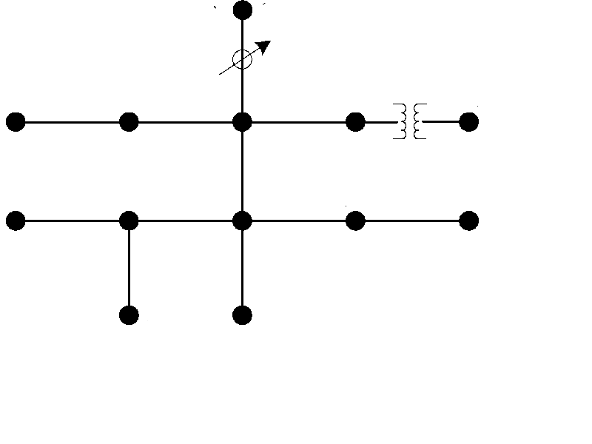
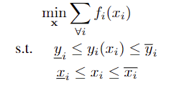
Distributed Volt-Watt Optimization
Volt-Watt Control (VWC) Problem
Iteratively takes care of modelling errors!!
Primal-Dual Method for solving the problem above
independently solves OPTDIST-VWC algorithm based on modified primal-dual method for VWC

Slide 6
MPP of DERs
Algorithm requirements: Voltage measurements → Variable Calculation → Set-Point Deployment → Neighbor Communicate
Communication latency? Computation time?
We use old measurements for variable calculation and deployment → But DER out put might have already changed!! → Resulting setpoints many not be deployable
Solution? Use old measurements for variable calculation, and new MPP for setpoint update

Slide 7
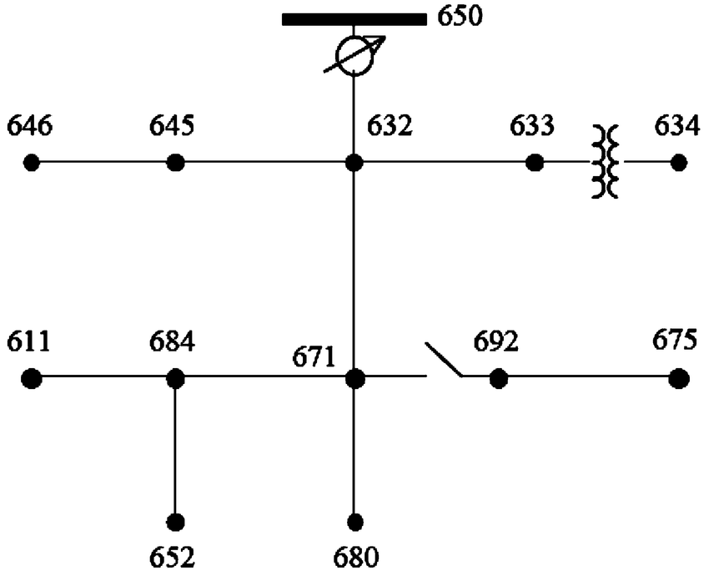
Cyber-Power Test-bed
Deployed in Mininet Hosts
Coordination Application
Distributed Optimization Application
Cyber
Attack
Application
Power System Layer : Developed with OpenDSS
Cyber Layer: Developed with Mininet
h650
h646
h645
h632
h633
h634
Application Layer : Developed with Python
Python Wrapper
h611
h684
h671
h692
h675
Python Wrappers binds all three layers
DERs Setpoint
Mininet
Power System Data
h652
h680
Challenges:
Data flow among layers
Time synchronization
Running applications in Mininet hosts
Facilitate Plug-&-Play Capability
OpenDSS
P. S. Sarker, N. Patari, B. Ha, S. Majumder, and A. K. Srivastava, “Cyber-power testbed for analyzing distributed control performance during cyber-events,” in Proceedings of the 9th Workshop on Modeling and Simulation of Cyber-Physical Energy Systems, 2022.

Slide 8
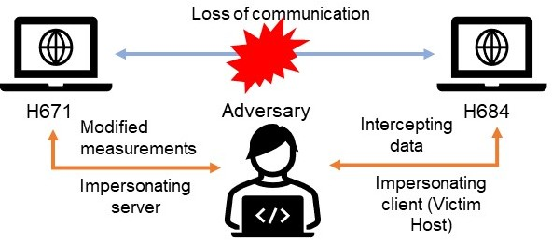
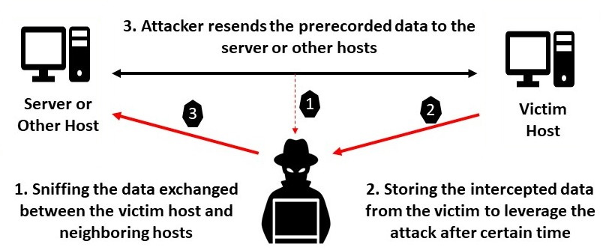
Cyber-Power Test-bed
Cyber Attack Application:
MitM attack
DOS attack
Replay attack

Slide 9
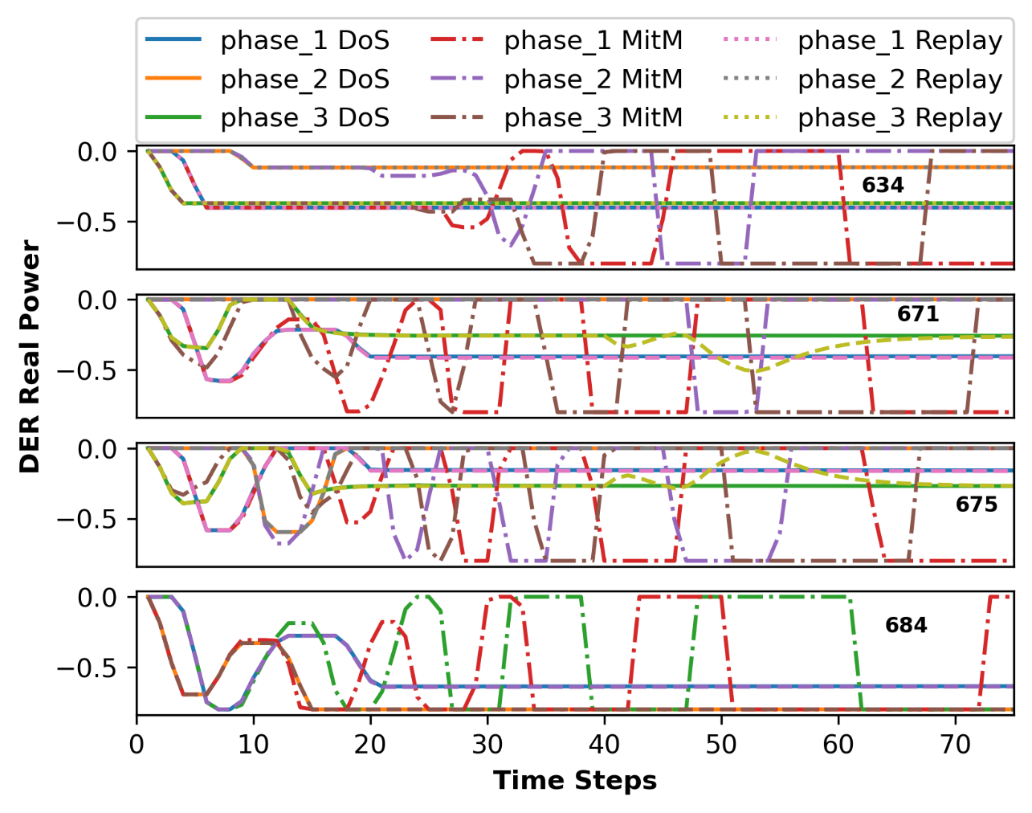
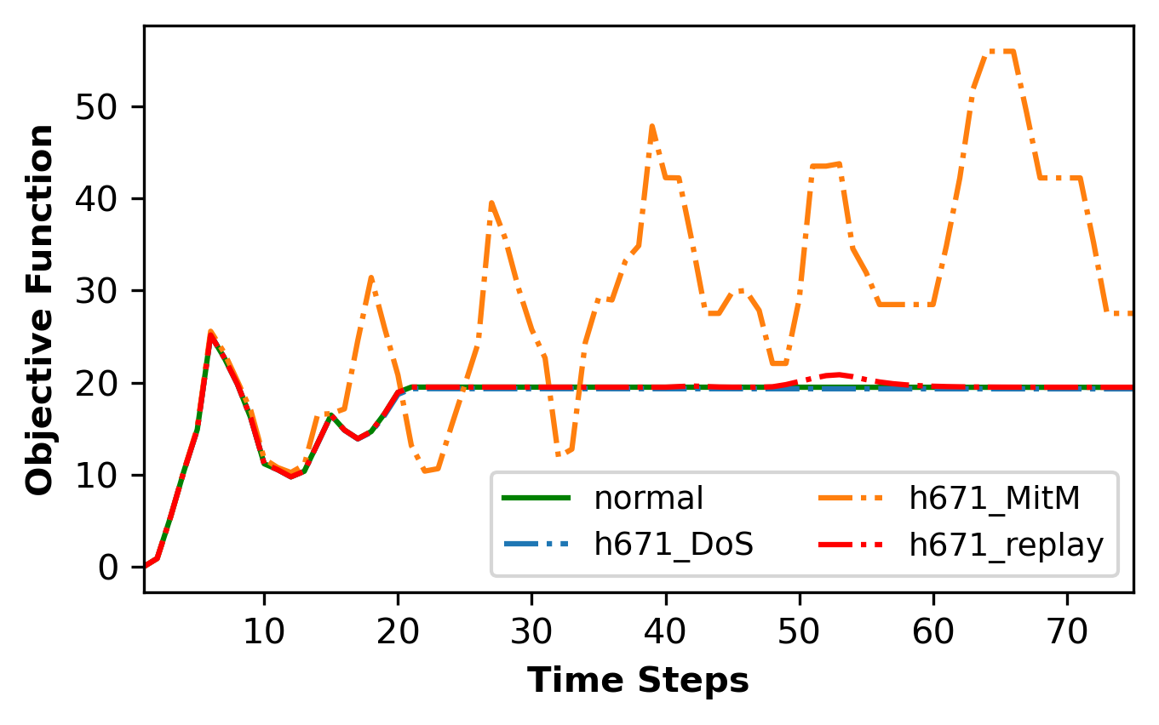
Test Cases & Results
Use case:
DERs are connected at nodes 671, 684, 675, and 634.
h634 and h671 are under attack with MitM, DoS, and Replay individually.

Slide 10
Conclusions
Developed
Distributed feedback-based volt-watt controller guaranteeing asymptotic convergence of voltage-related constraints
Analyzed
Performance of distributed control during different cyber-attacks
Findings
Effects of cyber-attacks on distributed volt-watt control in different nodes of the distribution system
Advantages
This study facilitates executing multiple control applications simultaneously to show performance analysis under different cyber vulnerabilities
Distributed controllers need to be able to identify cyber-attacks and isolate rogue nodes and self-organize
Realistic cyberattack scenarios in cyber-power testbed to test performance of distributed control application
Distributed control is not immune to cyber-attacks
The understanding of this study paves the way to develop more cyber-resilient control algorithms

